Slide 1
Group 6: iPad
Ayman, Sooriya, Edward
Notes:
Ayman: slides 10-12, Edward: slides 2-5, Sooriya: slides 6-9

Slide 2
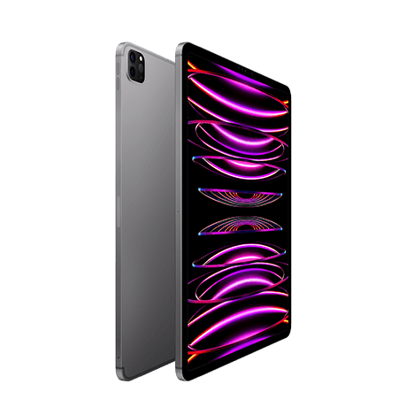
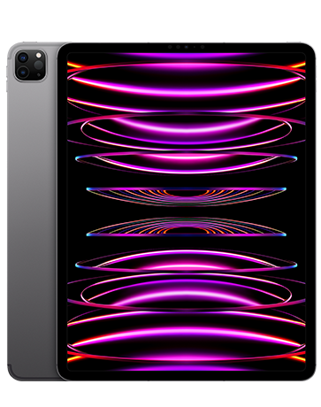

iPad Pro 2022, 12.9 inch
Notes:
Image citations:
https://upload.wikimedia.org/wikipedia/commons/f/fa/Apple_logo_black.svg
https://m.media-amazon.com/images/I/71brAk7Sc2L._AC_UF894,1000_QL80_.jpg
https://store.storeimages.cdn-apple.com/4982/as-images.apple.com/is/ipad-pro-finish-select-202212-12-9inch-space-gray-wifi_FMT_WHH?wid=1280&hei=720&fmt=p-jpg&qlt=95&.v=1670865949310

Slide 3
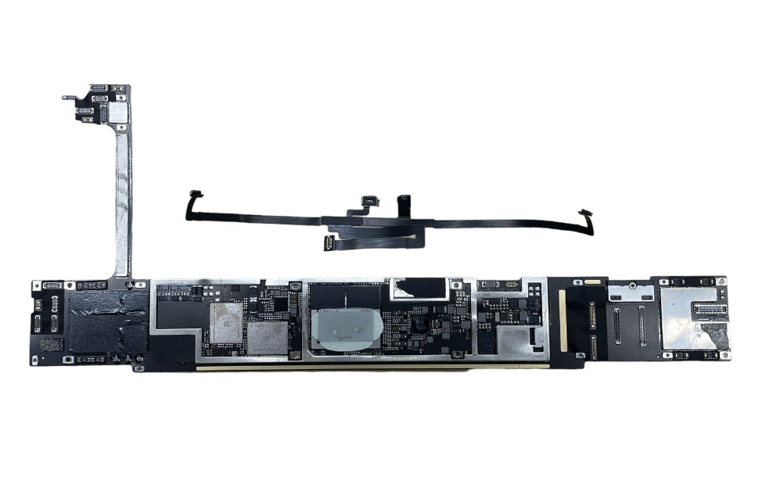
Motherboard
Apple iPad Pro 12.9 6th gen A2764 Power Logic Board
Wifi capabilities, connectors for the CPU, memory, storage, and all other parts of the device^{[5]}
Acts as a circuit board which connects all parts, distributes electricity from the battery, and allows parts to ‘talk to’ each other^{[4]}
Notes:
Image Citation:
https://i.ebayimg.com/images/g/16kAAOSwu6xkjLG4/s-l500.jpg

Slide 4
Operating System
iPadOS 16
Features for productivity, security, accessibility, and much more^{[1]}:
Siri allows you to quickly perform actions or access apps
Stage manager offers a new way to multitask and improve productivity
Improved security and face ID allows for more convenient and safe sign ins
Notes:
Video citation:
https://www.apple.com/105/media/ca/ipados/ipados-16/2022/5114b4f7-3907-4e61-aa91-33e371c15d53/anim/stage-manager/large_2x.mp4

Slide 5
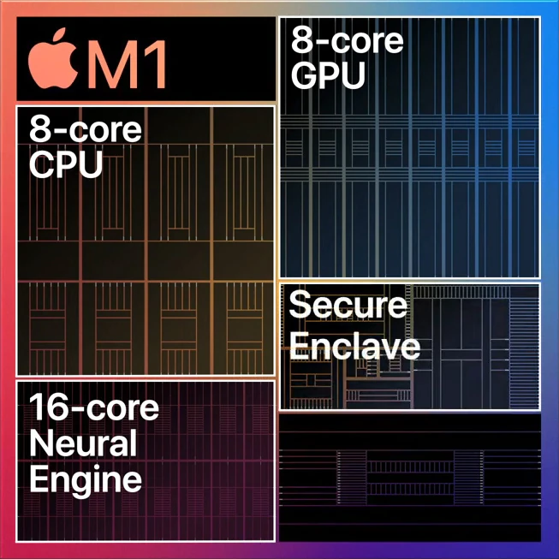
Neural Engine
A group of specialized cores dedicated to speeding up AI operations and machine learning tasks^{[12]}
These tasks include Siri, speech recognition, accessibility assistants, and much more
The Neural Engine itself has 16 cores, and is an extremely powerful way to perform Ai related tasks

Slide 6
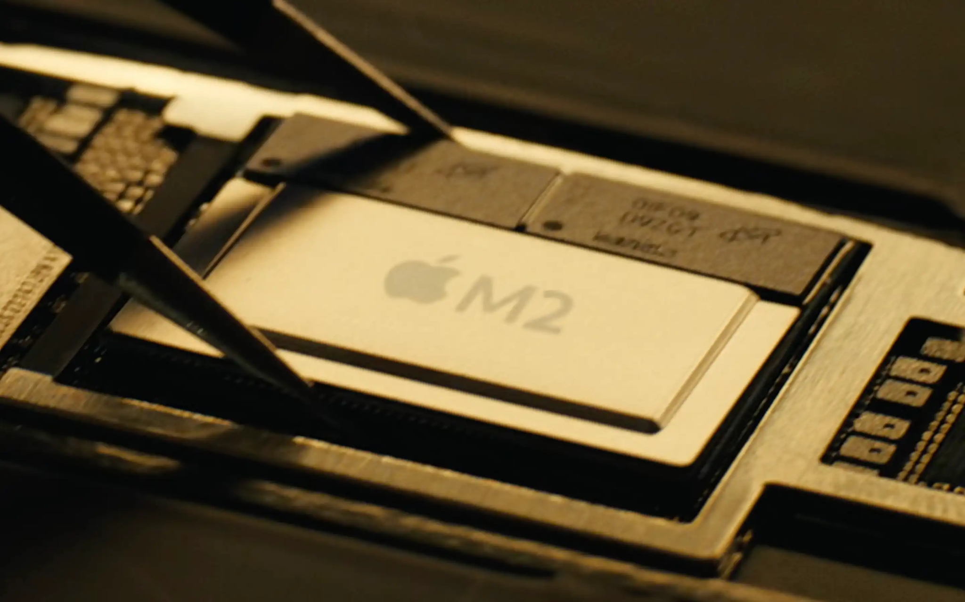
Central Processing Unit (CPU)
The CPU interprets, processes and executes instructions, most often from the hardware and software programs running on the device. The CPU performs arithmetic, logic, and other operations to transform data input into more usable information output.^{[8]}
The M2 contains dedicated neural network hardware in a 16-core Neural Engine capable of executing 15.8 trillion operations per second.^{[9]}
The engine only aids the CPU in machine learning and AI related tasks, the CPU itself is comparable to the i7-1255u found in Samsung Galaxy Book2 360.
Notes:
https://www.macworld.com/article/626763/ipad-pro-with-m2-coming-this-fall.html

Slide 7

Memory
The memory, also referred to as random access memory (RAM) is used for immediate data storage and retrieval^{[6]} and this device comes with:
8GB RAM on models with 128GB, 256GB or 512GB storage.
16GB RAM on models with 1TB or 2TB storage.^{[3]}
Notes:
iPad RAM list: How much memory every model has - 9to5Mac

Slide 8
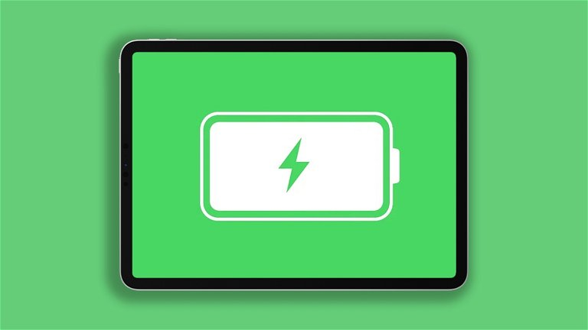
Graphics Card
The graphics card, also known as Graphics Processing Unit (GPU), is responsible for calculating images in a computer, which can then be displayed on a monitor.^{[10]}
The GPU in this device is integrated into the CPU. Integrated GPUs use shared system memory(RAM), which allows them to conserve power by utilizing the existing resources of the CPU.^{[11]} This gives the Ipad more battery life.
Notes:
Hoe de batterijstatus van een iPad te kennen - Crest.net (crast.net)

Slide 9
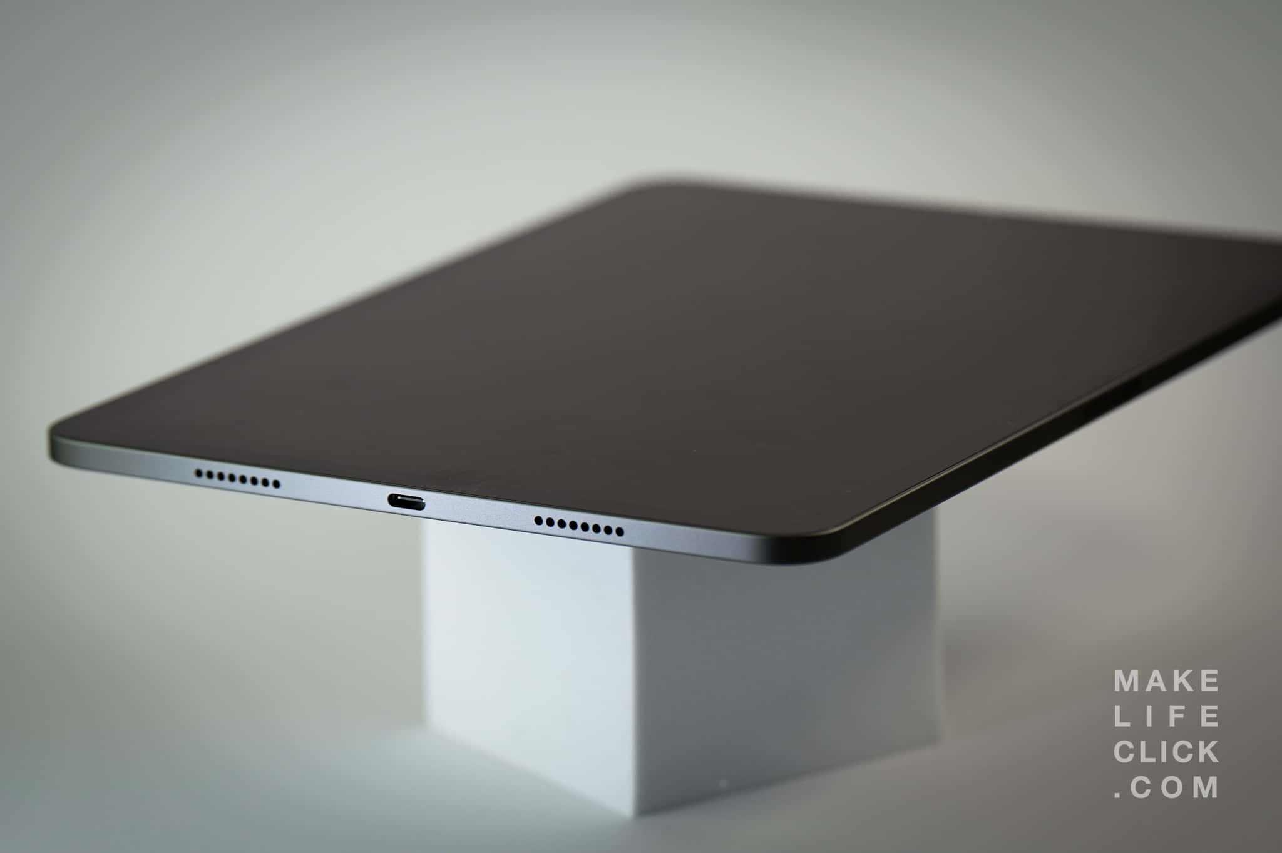
Audio Devices
Two speakers are placed parallel on each side to ensure the best experience with dolby atmos support.
Notes:
https://makelifeclick.com/ipad-pro-11-m1-review-2022/

Slide 10
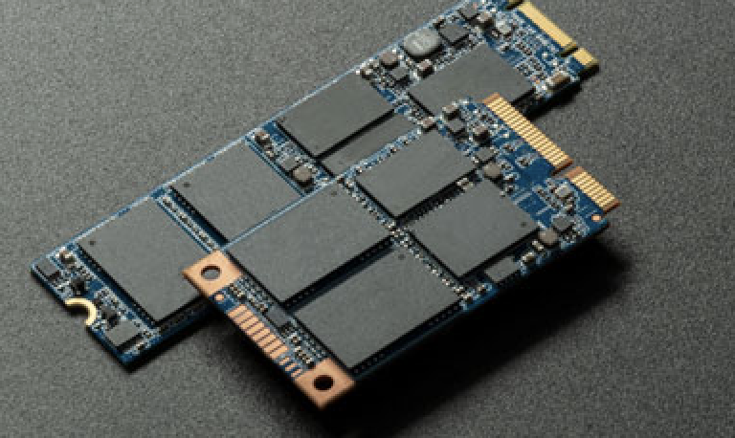
Storage Devices
NAND flash memory is a type of electronic storage found in devices such as the iPad Pro, with capacities ranging from tiny to big (e.g., 16GB to several terabytes), allowing data to be stored electronically without the necessity of moving components.

Slide 11
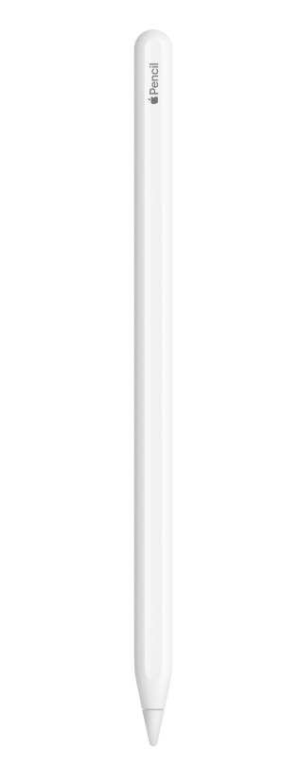
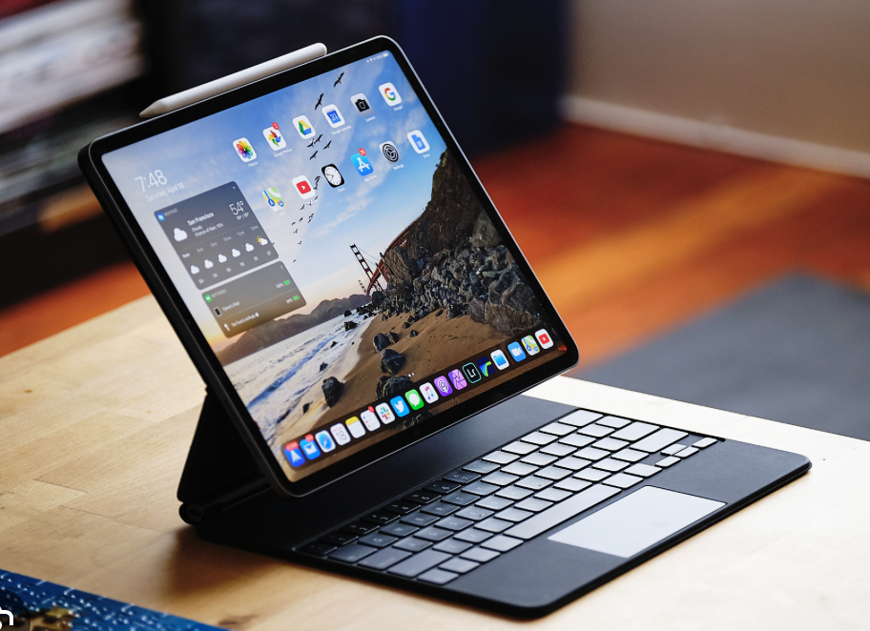
Input Devices
The Magic Keyboard Folio is the ideal iPad accessory. It has a fantastic typing experience, a built-in touchpad for precise jobs, and a 14-key function row.
The two-piece design comprises a detachable keyboard and a protective rear cover that magnetically attach to the iPad.
The Apple Pencil (2nd edition) has pixel-perfect precision and industry-leading low latency, making it ideal for drawing, sketching, coloring, taking notes.
The Apple Pencil (2nd edition) allows you to change tools without putting it down, thanks to its intuitive touch surface that supports double-tapping.

Slide 12
Input devices
Capacitive touch screens are control displays that accept input from the electrical properties of the human body. When a finger (or other specialized input device, such as a pen) comes into contact with the display, it identifies when and where the user touches the display.

Slide 13
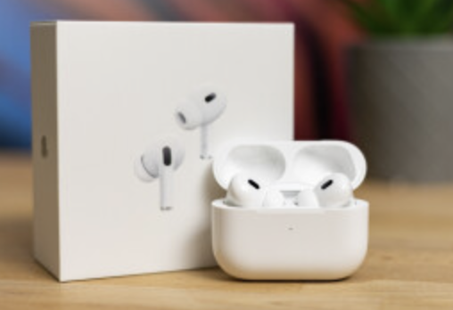
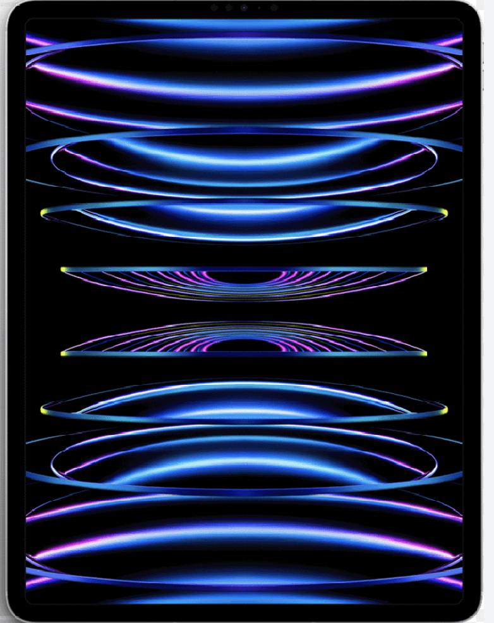
Output Devices
Th
The IPS LCD screen on the 12.9-inch Liquid Retina XDR display supports a resolution of 2732 by 2048 pixels for a total of 5.6 million pixels at 264 pixels per inch. To achieve Extreme Dynamic Range on the iPad Pro, an entirely new display architecture was necessary. The all-new 2D mini-LED backlighting system with individually regulated local dimming zones was the best choice for delivering the extraordinarily high full-screen brightness and contrast ratio, as well as off-axis color accuracy, that creative professionals rely on.
The AirPods Pro (3rd Edition) are a pair of wireless headphones that have a slew of new and improved features.
Such is personalized spatial audio, fast connections, exceptional detection abilities, and many more. features

Slide 14
Bibliography
[1] “iPadOS 16,” Apple (Canada). https://www.apple.com/ca/ipados/ipados-16/ (accessed Sep. 08, 2023).
[2]“iPad Keyboards,” Apple (Canada). https://www.apple.com/ca/ipad-keyboards/ (accessed Sep. 08, 2023).
[3] “Apple iPad Pro 12.9 (2022) Wi-Fi - Specifications,” DeviceSpecifications. https://www.devicespecifications.com/en/model/d7265ae3 (accessed Sep. 08, 2023).
[4] “How to Choose a Motherboard,” Intel. https://www.intel.com/content/www/us/en/gaming/resources/how-to-choose-a-motherboard.html#:~:text=What%20does%20a%20motherboard%20do
[5] “iPad Pro,” Apple, 2019. https://www.apple.com/ipad-pro/
[6]“What Is RAM and Why Is It Important?,” What Is RAM and Why Is It Important? https://www.avast.com/c-what-is-ram-memory#:~:text=RAM%20is%20used%20for%20immediate%20data%20storage%20and%20retrieval%20%E2%80%94%20any
[7]“Buy iPad Accessories,” Apple (CA). https://www.apple.com/ca/shop/ipad/accessories (accessed Sep. 09, 2023).
‌[8]A. Ltd, “What is a Central Processing Unit? – Arm®,” Arm | The Architecture for the Digital World. Available: https://www.arm.com/glossary/cpu#:~:text=The%20CPU%20interprets%2C%20processes%20and
[9]“Apple M2,” Wikipedia, Aug. 28, 2023. Available: https://en.wikipedia.org/wiki/Apple_M2#:~:text=The%20M2%20contains%20dedicated%20neural. [Accessed: Sep. 10, 2023]
[10]N. Lang, “Why does a Graphics Card help in Machine Learning?,” Medium, Dec. 09, 2022. Available: https://towardsdatascience.com/why-does-a-graphics-card-help-in-machine-learning-8f365593b22
[11]“Are integrated or dedicated GPUs more power efficient?,” Quora. Available: https://www.quora.com/Are-integrated-or-dedicated-GPUs-more-power-efficient#:~:text=Integrated%20GPUs%2C%20which%20are%20built. [Accessed: Sep. 10, 2023]
[12] T. Simonite, “Apple’s ‘Neural Engine’ Infuses the iPhone With AI Smarts,” Wired. https://www.wired.com/story/apples-neural-engine-infuses-the-iphone-with-ai-smarts/

